Slide 1
Lecture 15: Evaluate Peer’s Prototype
Dr. Tsung-Wei Huang
Department of Electrical and Computer Engineering
University of Utah, Salt Lake City, UT
Notes:
Hello everyone, today we are going to help you go through the team forming process.

Slide 2

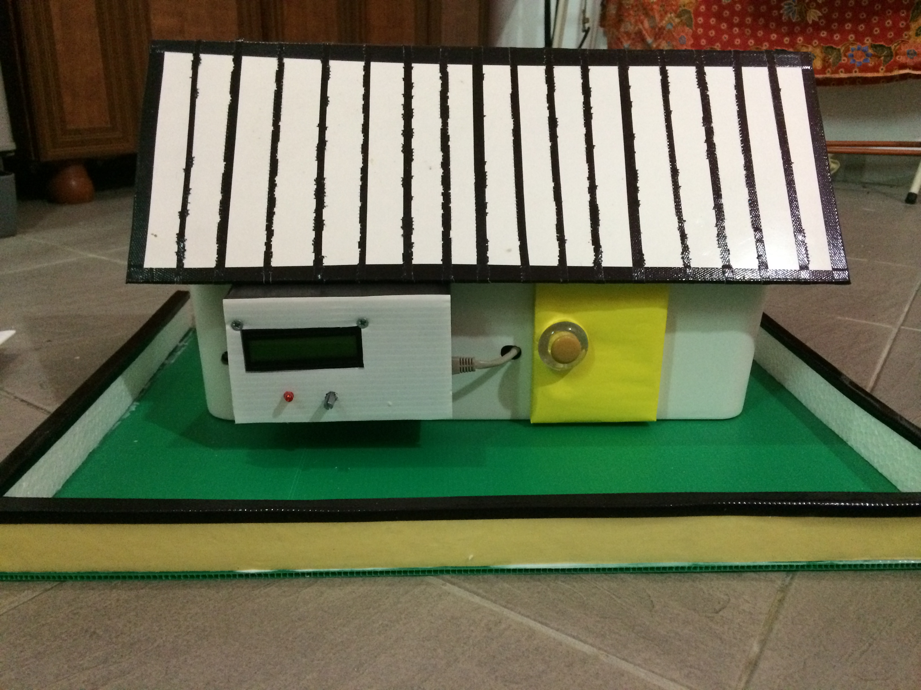
Each Team has Talked About its Prototype
What is a prototype?
Final Goal: A house
Prototype: a small type of work to demonstrate the feasibility of your proposed approach to the final goal.
Key question: why should I believe in your proposed technical work?

Slide 3
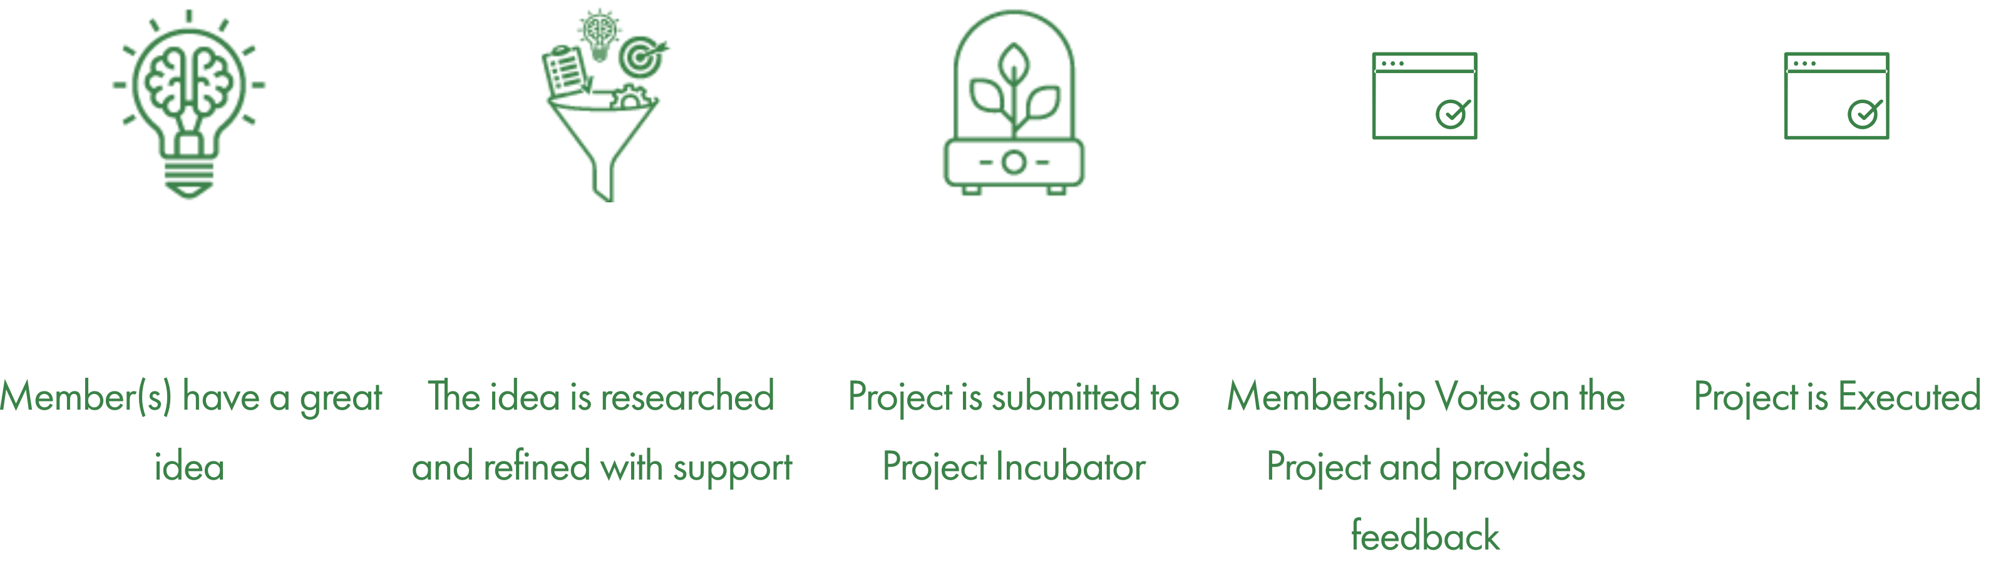
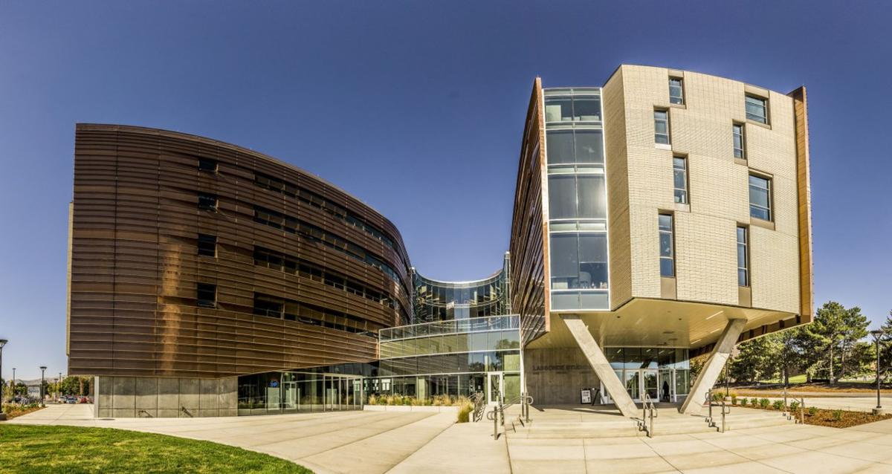

Considering You Start Up a Company
University of Utah business startup lab
prototype
NSF I-corp
University of Utah’s business startup center

Slide 4
How Do I Know My Prototype is Good or Not?
In fact, there is no universal solution to judge it
Otherwise, everyone can start up a company and make a lot of money
It depends on three parts
Your project vision direct the prototype
Your technical capability dominates the prototype
Your budget (time + money) constrain the prototype
The most effective way is to talk to other people
Do you think my prototype make sense?
Do you think my prototype paves a way to the goal?
Will you invest in my project after seeing the prototype?

Slide 5

Again, It’s All About Convincing Others
Are you convinced to take the COVID vaccine?

Slide 6
Project Prototype Discussion
We have opened 10 breakout rooms
Zoom: https://utah.zoom.us/j/2468214418
1-9 are assigned for each team
Thesis track students are in room 10
Each group work together to do the following:
Spend the first 20 mins to refine and upload your prototype idea from the last lecture (https://docs.google.com/spreadsheets/d/1JfWZkEyoXdVLtHkiwOqk24G7WVhLWMCP113cSe9fgsQ/edit#gid=946490439) to your project website
Project Website v3 (due this Fri) MUST contain your prototype items you plan to finish and demonstrate at the end of semester

Slide 7
Project Prototype Discussion (cont’d)
Next 30 mins of today’s lecture and Friday’s lecture:
Each group reviews all others’ prototype
Discuss the following items as if you were an investor:
Is the prototype related to the project? (with comments)
Is the prototype convincing for you to invest? (with comments)
Post your comments at the issue post of each other project at here: https://github.com/tsung-wei-huang/cs3992/issues
Each group can provide a single collective comment but you must review all other projects

